Slide 1


Welcome to .NET Conf: Focus on Windows
Scott Hunter and friends
Director Program Management, .NET
@coolcsh
Notes:
Welcome to .NET Conf – Focus on Windows! We’re very excited to bring you another event that focuses on specific things you can do with .NET. Today, we’re going to talk all about Windows desktop development.

Slide 2


.NET
Your platform for building anything
Desktop
Web
Cloud
Mobile
Games
IoT
AI
Notes:
You can build anything with .NET.
From desktop to web to mobile to IoT, you can literally build anything. .NET is free, cross-platform, and open source. It is designed to be general-purpose so that once a you learn how to build one type of application, you can quickly build other types of applications for completely different workloads – your skills can easily transfer to other domains using the same languages and libraries.
.NET enables developers to be more productive building feature-rich applications of any type, for any device with great performance.
<CLICK>

Slide 3




.NET – A unified platform
TOOLS
DESKTOP
WEB
CLOUD
MOBILE
GAMES
IoT
AI
VISUAL STUDIO
VISUAL STUDIO FOR MAC
.NET
LIBRARIES
VISUAL STUDIO CODE
INFRASTRUCTURE
CLI
RUNTIME COMPONENTS
COMPILERS
LANGUAGES
Notes:
We’ve made significant advancements in the platform since it was open sourced in 2014. Together, Microsoft and the community has extended the capabilities of .NET to cover workloads we never had before, like Linux workloads and Machine Learning & AI. And we’ve got a full set of tools with the Visual Studio family all with great support for .NET.
<CLICK>

Slide 4
.NET – A unified platform
TOOLS
WINDOWS DESKTOP
WEB
CLOUD
MOBILE
GAMES
IoT
AI
VISUAL STUDIO
VISUAL STUDIO FOR MAC
.NET
LIBRARIES
VISUAL STUDIO CODE
INFRASTRUCTURE
CLI
RUNTIME COMPONENTS
COMPILERS
LANGUAGES
Notes:
Today we’re going to focus on Windows desktop apps and how to bring them forward to the modern .NET 5 platform.
<CLICK>

Slide 5
.NET adoption
.NET Core
2M
.NET Core / .NET 5 monthly active developers
5 million
.NET developers
Monthly active developers in Visual Studio Family
WinForms & WPF on .NET Core
260K
Windows developers upgraded to .NET Core / .NET 5
Notes:
Let’s talk numbers first. The .NET user base keeps growing!
There are over 5 million monthly active .NET developers in Visual Studio Family, which includes Visual Studio, Visual Studio Code, and Visual Studio for Mac. As I mentioned we’ve seen significant growth with .NET Core, our open source, cross-platform .NET, and it’s now surpassed 2 million active developers per month. We also are seeing a significant number of Windows desktop developers, over 260 thousand, upgrade to .NET Core and .NET 5 from .NET Framework.
<CLICK>

Slide 6





Controls for Windows apps on .NET 5
PARTNERS
Notes:
.NET has a rich ecosystem of partners building additional tools and controls to help you build beautiful, full-featured, applications faster. We have many partners releasing support for Winforms, and WPF on .NET 5 in their tools and controls as well. SyncFusion, Progress Telerik, Infragistics, GrapeCity and DevExpress all have great controls for multiple app models for .NET 5. Most of them are also supported in the designer today and more are coming with designer support soon.
THANK YOU!!
<CLICK>
Notes:
Telerik: Full design-time support
GrapeCity: Our .NET 5 controls do support the designer already, and we are working to support .NET Framework controls in the .NET 5 designer. We want customers to move to .NET 5 controls which 100% support the designer.
Infragistics: Yes, we have .NET 5 controls for WPF, Windows Forms, Blazor, and MVC. Design time for WPF (released last year) and Windows Forms (customers have access in release beta, might RTM next month), Tag Helpers across all the MVC / web products. See: https://www.infragistics.com/community/blogs/b/infragistics/posts/announcing-infragistics-ultimate-20-2-what-s-new.
Syncfusion: Yes, we can confirm that we are working on designer support.
DevExpress: Yes, we are working on designer support.

Slide 7
.NET 5
Windows desktop development enhancements
Windows ARM64 support
Single file applications & smaller container images
Web and cloud investments
Continued performance improvements
New C# 9.0, F# 5.0 language features
dot.net/get-dotnet5
Notes:
.NET 5 release last November at our big, three-day, .NET Conf main event.
There’s a lot of good stuff for Windows developers in .NET 5. .NET 5 includes full design-time support for Windows Desktop development (WinForms and WPF) in Visual Studio, with first and third-party control support, Clickonce support, and side-by-side, single file deployment. There are also many runtime performance improvements, support for Windows ARM64, and new releases of languages C# 9.0 and F# 5.0.

Slide 8
Upgrading to .NET 5
Notes:
Let’s start digging into the new features of the release with a focus on Windows developers. I first want to talk about “Why” you’d want to move your current .NET Framework-based apps to .NET 5.
<CLICK>

Slide 9
Why .NET 5?
.NET Framework
Flexible deployment
Unparalleled performance
Reduced infrastructure & hosting costs
Modern, innovative languages and APIs
.NET
.NET Core
Mono / Xamarin
Notes:
Animated slide
Our vision for one .NET is to simplify the platform and choices for .NET developers and provide a single stack that supports the best of breed solutions for all modern workloads and operating systems. We’ve taken the best of .NET Framework and put that into .NET Core, including many familiar APIs, as well as Windows desktop apps with WPF and WinForms. Now we are unifying all the platform, SDK, and tools by bringing in Mono and Xamarin.
.NET Core and .NET 5 can be deployed side-by-side giving you ultimate deployment flexibility. This also allows the .NET authors to innovate quicker without fear of breaking existing applications as is the case with .NET Framework on Windows. For .NET 5 we have also focused on several cloud & web investments, which can provide reduced infrastructure and hosting costs particularly when hosting on Linux in Azure.
.NET 5 is the focus of our investments in the .NET platform going forward, which makes it the logical choice for any .NET based application.
There’s also a lot of benefits here for client apps.
<CLICK>

Slide 10
Why .NET 5 for Windows apps?
Enhanced development experience in Visual Studio
Self-contained, single file EXEs
Flexible deployment; side-by-side, ClickOnce
Latest language & API enhancements
Modern controls like WebView2
Third-party tools and controls
.NET
Notes:
We know there are millions of Windows desktop applications out there written many years ago that are still business critical today that are being actively developed. We want to make sure these apps not only run on the latest .NET but can also be developed with the latest version of Visual Studio. That’s why we’ve worked to bring these workloads to .NET Core and now .NET 5.
With .NET 5, we’ve completed this work by bringing the full Visual Studio development experience to you, including third-party control and component vendors you may be using today, and clickonce installer support. By moving forward, these apps can get all the benefits of .NET 5 like self-contained, single file EXEs that don’t need the .NET Framework on the machine. You decide when you want to update, not the Windows OS. You can also use new, modern Windows 10 controls like WebView2, a modern browser control based on Microsoft Edge Chromium.
Now we know it can be time consuming porting your applications from .NET Framework to the latest .NET versions. How can you get here more quickly?
<CLICK>

Slide 11
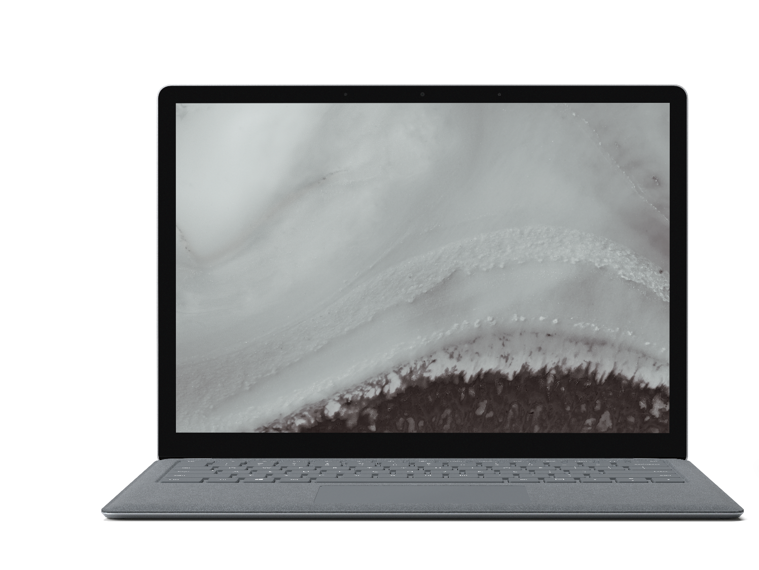
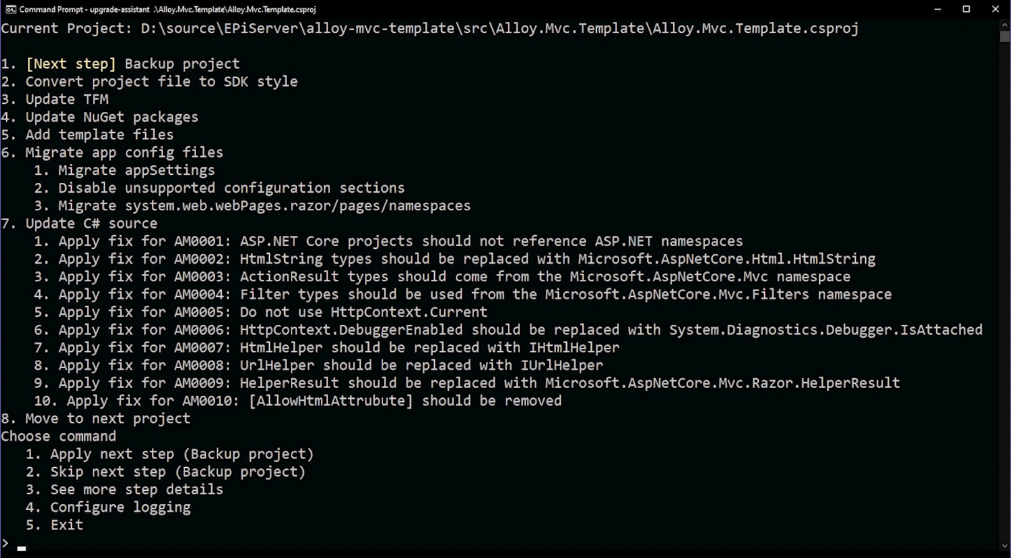
.NET Upgrade Assistant
Guided, step-by-step experience
Reduce time and difficulty modernizing older .NET codebases
Multiple project types supported
aka.ms/dotnet-upgrade-assistant
Notes:
We have something we’re building to help you….
Today, I’m excited to announce the new .NET Upgrade Assistant preview
The .NET Upgrade Assistant is a .NET global tool providing you a step-by-step guided experience on how to incrementally upgrade you .NET Framework-based Windows applications to .NET 5.
Install quickly as a dotnet global command-line tool.
Analyze NuGet packages and understand where your dependencies are.
Step-by-step recommendations and fixes for project files, configuration, and source code to help you incrementally upgrade at your own pace.
Multiple project types are supported
ASP.NET MVC web apps
Windows Forms and WPF desktop apps
Console apps & libraries
WCF services and ASP.NET WebForms are coming later
It’s open source on GitHub and we’re accepting community feedback.
In fact, we’re working with customers like Optimizely EpiServer to upgrade large enterprise solutions today in order to take full advantage of .NET 5 and cost-savings benefits of running on Linux in Azure.

Slide 12
Windows Forms on .NET 5

Slide 13
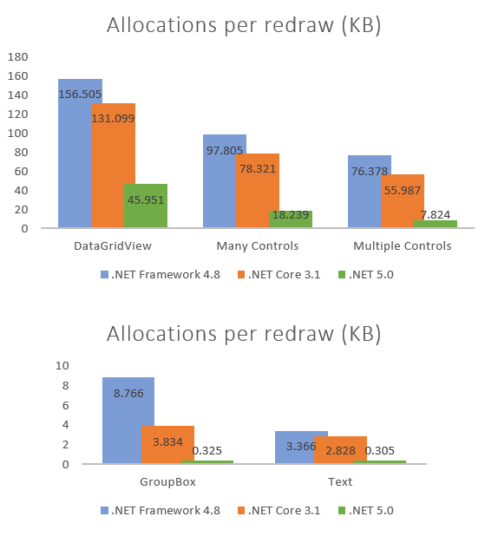
What’s new in Windows Forms?
Performance improvements
Visual Basic support
New and updated controls
ClickOnce Deployment
Modern Browser Control (WebView2)
Accessibility improvements
SDK for third-party control vendors in preview
Notes:
Performance – We refactored the old WinForms code to use GDI instead of GDI+ where possible and benefit from newer APIs. These optimizations resulted significant reduction in memory consumptions in redraw paths, in some cases saving x10 in memory allocations. (blog post: https://devblogs.microsoft.com/dotnet/whats-new-in-windows-forms-runtime-in-net-5-0/#performance-improvements)
Visual Basic (blog post: https://devblogs.microsoft.com/dotnet/visual-basic-winforms-apps-in-net-5-and-visual-studio-16-8/)
New and updated controls - New TaskDialog control and improvements in ListView (blog post: https://devblogs.microsoft.com/dotnet/whats-new-in-windows-forms-runtime-in-net-5-0/#windows-controls-additions-and-enhancements)
Accessibility – updated controls to meet today’s accessibility requirements (blog post: https://devblogs.microsoft.com/dotnet/whats-new-in-windows-forms-runtime-in-net-5-0/#accessibility-improvements-and-fixes)
SDK for third-party control - we are working with the control vendors on our SDK and making great progress together. (16.9 RTM)

Slide 14
Demo Windows Forms
Olia Gavrysh
Senior Program Manager, .NET
Notes:
Demos (10min)
WinForms – Pie Graph app
Performance on .NET 5
Designer progress with 3rd party control support
ClickOnce deployment
WPF – Baby Smash
Port to .NET 5 with Upgrade Assistant

Slide 15
WPF on .NET 5

Slide 16
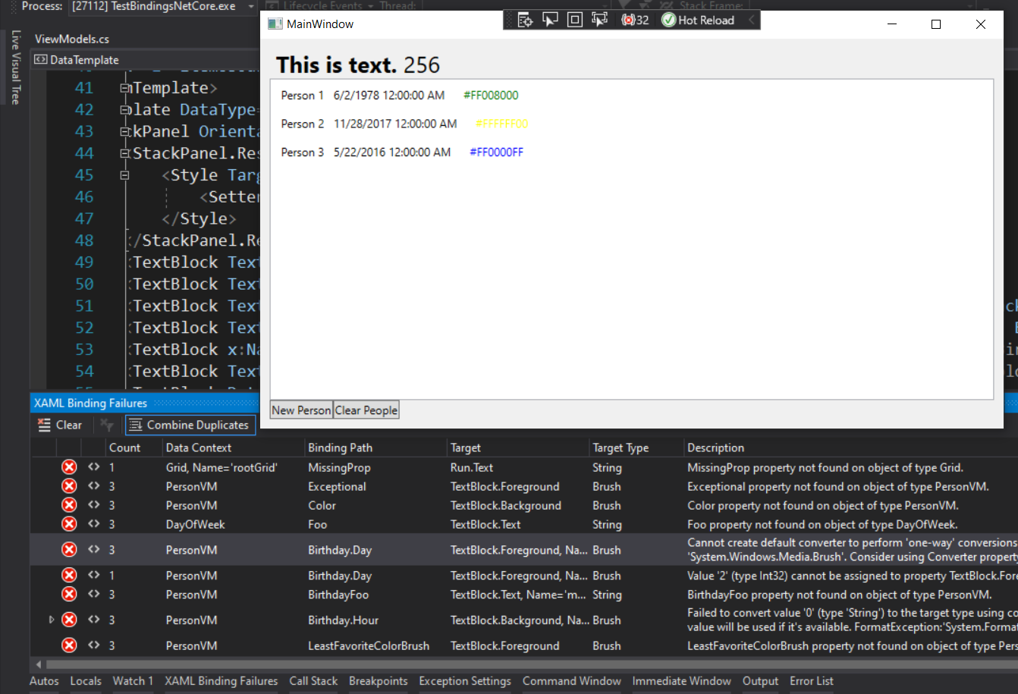
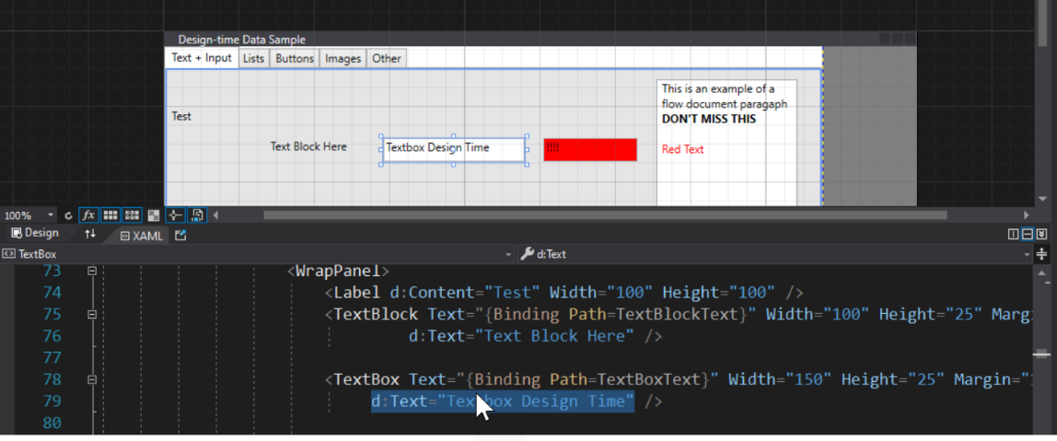
What’s new in WPF?
XAML Hot Reload Improvements
Data Binding Failure Detection & Diagnostics Experience
Simplified Design-time Data using d: (XAML Designer)
IntelliSense Improvements for MVVM scenarios
ClickOnce Deployment & Modern Browser Control (WebView2)
Notes:
For WPF customers we've tackled one of the top customers asks, bringing back ClickOnce for deployment and it's available as you already know for both Windows Forms and WPF developers targeting .NET 5. Similarly WebView2 is also available to bring the modern web control story for WPF developers as well.
In addition customers targeting .NET 5 get many new XAML tooling enhancements, this includes:
Our ever improving XAML Hot Reload feature that makes it possible for you to update your apps UI while the app is running with real data
The new data binding diagnostic experiences that makes sure you don't miss binding failures in your app and are able to navigate right to where the error is located in your XAML
The new and easy to use 'design-time data using d:' for XAML designer, this makes it possible for you to quickly mock almost any property or control without ever having to run your app
And more
So let's jump into a demo of these new XAML features with Dmitry

Slide 17
Demo WPF
Dmitry Lyalin
Senior Program Manager, .NET
Notes:
Demo (10min)
XAML Tooling
XAML Hot Reload
Data Binding Diagnostics
Design-time Data
MVVM IntelliSense Improvements

Slide 18
The Future of .NET Framework
.NET Framework 4.8 is the last major version of .NET Framework on Windows
Support policy remains the same:
Will always be in Windows
Will be patched with Windows
Will be supported with Windows
You can keep existing applications on .NET Framework
Notes:
But it’s OK if you can’t move right away.
As we continue to innovate and focus on modern platform capabilities, we are at a point where we will be providing only critical updates to .NET Framework on Windows. This means that applications running on .NET Framework will continue to run the same as they always have. However, this also means that any new development should be with .NET 5+ moving forward.

Slide 19
Release schedule, support & patching
Patches for 3 years
LTS
.NET Core 3.1
Dec 2019
.NET 5
Nov 2020
3.1.12
Latest patch
5.0.3
.NET 6
Nov 2021
.NET 7
Nov 2022
.NET 8
Nov 2023
Current
Patches for 15 months
Predictable schedule with major releases every November going forward
Even numbered releases are Long Term Support (LTS) releases
LTS releases get patched for a longer timeframe (3 years) as opposed to Current (15 months)
You must update to the latest patches to be supported regardless of Current or LTS
Quality of all releases are exactly the same, patches are for critical bugs
You decide when you want new features and to plan the upgrade

Slide 20
Automatic patching on Windows
Started in December via Microsoft Update
.NET Core 2.1, 3.1 & .NET 5 (currently supported versions)
Patching happens in-place with “runtime roll-forward”
Only applies to .NET global installs
Enables organizations to manage updates the same way as .NET Framework
Notes:
Automatic patching on client and server

Slide 21
Windows developer landscape today

Slide 22
The wonderful world of Windows app models
2002: Windows Forms (WinForms)
2006: Windows Presentation Foundation (WPF)
2015: Universal Windows Platform (UWP XAML)
2020: “Project Reunion” (WinUI 3)
Notes:
Over the years we’ve brought you three app models for building Windows desktop apps with .NET. The first, Windows Forms, brings a WYSIWYG design experience for building “Forms over Data” custom business applications quickly. In 2006, with the completely redesigned Windows Vista, we got WPF and a new paradigm for defining application UI with a markup language called “XAML” was born. With UWP XAML, we can build apps for multiple Windows devices, such as Windows 10, Xbox and HoloLens.
<CLICK>
Now we’re working to unify these with “Project Reunion”. Announced Build last year, Project Reunion is a set of libraries, frameworks, components and tools that are common across all Windows 10 versions. For instance, you can take a WinForms app and access Windows 10 APIs, like say battery management, and deploy that app to any build of Windows 10. We’re on the first step on the journey to unify the Windows platform including Windows Forms, WPF and UWP.
We know that all of these app models are important to Windows developers. We also know that .NET developers want to be able to target as many devices as possible, not just Windows, with one codebase, with the great performance, and consistent user experiences that only native development can give you…..
<CLICK>

Slide 23
Going forward
Notes:
Let’s talk about how we’re addressing those needs in .NET 6

Slide 24




.NET Multi-platform App UI
.NET 6
Cross-platform, native UI
Single project system, single codebase
Deploy to multiple devices, mobile & desktop
General availability in .NET 6
.NET Multi-platform App UI
WinUI
Mac Catalyst
iOS
Android
macOS
iOS
github.com/dotnet/maui
Notes:
We’re making progress on .NET Multi-platform App UI that we announced almost a year ago at Build 2020. It will help you deliver performant, beautiful and consistent app experiences across various platforms and devices, and allow you to share code across your mobile and desktop apps. .NET MAUI under the hood uses technologies out there today for building native apps on Windows with WinUI, Mac Catalyst for macOS, and of course, iOS and Android. .NET MAUI abstracts all those frameworks into a single framework built on .NET 6.
<CLICK>
That means it will allow you to build these apps for any device from a single codebase and project system.
<CLICK>
And that includes desktop and mobile across operating systems, Windows, macOS, iOS and Android.
<CLICK>
It will be part of the unified .NET in the .NET 6 timeframe
<CLICK>
and preview 1 dropped last week so you can go check it out!

Slide 25
Blazor hybrid desktop apps
Blazor
Reuse UI components across native and web
Built on top of .NET Multi-platform App UI
Native app container & embedded controls
General availability in .NET 6
Can use native app
container & controls
.NET Multi-platform App UI
macOS
iOS
Notes:
Blazor has become a very popular way to write .NET web apps. We first supported Blazor on the server, then in the browser with WebAssembly, and now we’re extending it again, to enable you to write Blazor desktop apps in .NET 6. This enables you to create hybrid client apps, which combine web and native UI together in a native client application. It is primarily targeted at web developers that want provide rich client and offline experiences for their users.
Blazor hybrid apps is built on top of .NET Multi-platform App UI. It relies on that UI stack for a native application container and native controls (should you want to use them).
Although it will run anywhere .NET MAUI runs, for .NET 6, our primary focus for Blazor hybrid apps on desktop apps.

Slide 26
Demo .NET Multi-platform App UI

Slide 27
.NET 6 Preview 1
ARM64 support for Windows Forms & WPF
Continued performance improvements
Accessibility improvements
More productivity tools
aka.ms/get-dotnet6
Notes:
.NET 6 Preview 1 just dropped last week. For Windows Forms and WPF developers, .NET 6 will bring support for running on ARM64 (we have a session on that later today) as well as continued performance and accessibility improvements and more productivity tools in Visual Studio.
Check out the preview.

Slide 28
Agenda for the day
focus.dotnetconf.net/agenda
Upgrading .NET Desktop Apps from .NET Framework to .NET 5
09:00 (PT) | 17:00 (UTC) Cathy Sullivan
What's New in Visual Basic on .NET 5?
09:30 (PT) | 17:30 (UTC) Kathleen Dollard Klaus Loffelmann
Real-Time Desktop Apps with Azure SignalR Service
10:00 (PT) | 18:00 (UTC) Sam Basu
Practical Tips to Improve Your Users Experience
10:30 (PT) | 18:30 (UTC) Jessica Engström
XAML Productivity Tooling Enhancements in Visual Studio 2019
11:00 (PT) | 19:00 (UTC) Dmitry Lyalin
Contributing to WPF and Windows Forms Projects on GitHub
11:30 (PT) | 19:30 (UTC) Georgios Petrou Hugh Bellamy Igor Velikorossov Tobias Käs Olia Gavrysh
Mid-conference Break
12:00 (PT) | 20:00 (UTC) Jeff Fritz Kayla Cinnamon
Bringing your Windows Forms and WPF apps to ARM Devices
12:30 (PT) | 20:30 (UTC) Jeremy Sinclair
Deploying Windows Apps with ClickOnce on .NET 5
13:00 (PT) | 21:00 (UTC) Jasmine Greenaway Olia Gavrysh
An Opinionated Way to Deploy Windows Apps w GitHub Actions
13:30 (PT) | 21:30 (UTC) Isaac Levin
Bringing Desktop Apps to the Cloud with Azure and MS Graph
14:00 (PT) | 22:00 (UTC) Javier Lozano
Windows APIs Everywhere in .NET
15:00 (PT) | 23:00 (UTC) Mike Battista Angela Zhang
Building .NET Hybrid Apps with Blazor
15:30 (PT) | 23:30 (UTC) Daniel Roth
Project Reunion
16:00 (PT) | 00:00 (UTC) Zarya Faraj Miguel Ramos
The Future of Native Apps Development in .NET 6
16:30 (PT) | 00:30 (UTC) Maddy Leger David Ortinau
Ask questions on Twitter using #dotNETConf
Notes:
We have an awesome lineup for the rest of the day so we hop you’ll stick around and learn some things.

Slide 29
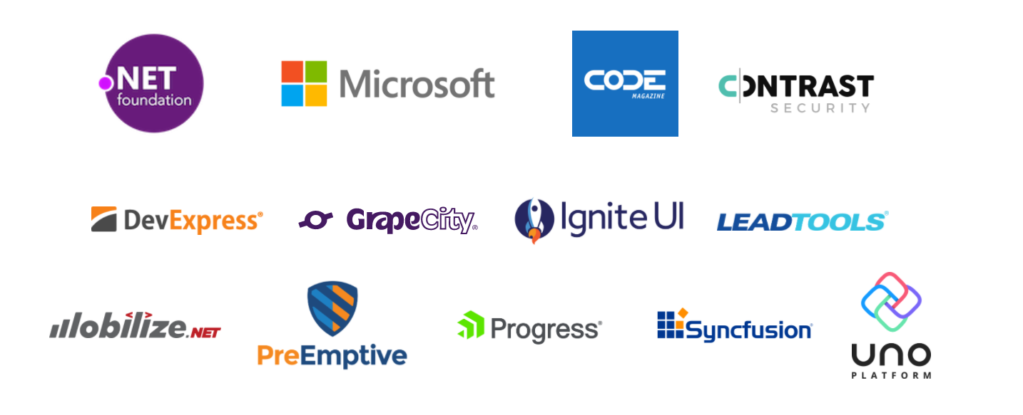
Thank you, .NET Conf sponsors!
focus.dotnetconf.net/swag
Notes:
Thank you to all of the sponsors of this focus event! They are giving away some fun swag bags so head to the SWAG page and enter to win. You can also get some free digital swag too!

Slide 30



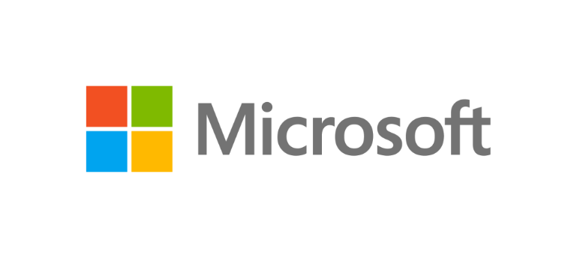

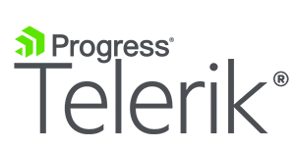


CORPORATE SPONSORS
.NET Foundation welcomes Uno Platform!
dotnetfoundation.org
Notes:
We’re also very happy to see the .NET Foundation announced that Uno Platform has joined as a corporate sponsor!
Uno Platform is an open source project which lets you build single-codebase applications with C# and WinUI for Windows, WebAssembly, Linux, macOS, iOS and Android.
Uno Platform joins the group of corporations that are helping drive the future of the .NET platform and ecosystem. Check out the .NET Foundation website for more info.
<CLICK>

Slide 31

Thanks for joining!
Ask questions on Twitter using #dotNETConf
Notes:
Thanks for joining us! Have a great conference!

Slide 32

Windows desktop apps on .NET 5
Complete development experience
Windows Forms & WPF designers
Visual Studio tooling
ClickOnce Installer support
Third-party tools & controls
All the benefits of .NET 5
Self contained, single file EXEs
No need for .NET Framework on machine
Best performance
Modern controls like WebView2
Notes:
We know there are millions of Windows desktop applications out there written many years ago that are still business critical today that are being actively developed. We want to make sure these apps not only run on the latest .NET but can also be developed with the latest version of Visual Studio. That’s why we’ve worked to bring these workloads to .NET Core and now .NET 5. We already have over 200 thousand Windows developers moved from .NET Framework to .NET Core. With .NET 5, we’ve completed this work by bringing the full Visual Studio development experience to you, including third-party control and component vendors you may be using today, and clickonce installer support. By moving forward, these apps can get all the benefits of .NET 5 like self-contained, single file EXEs that don’t need the .NET Framework on the machine. You decide when you want to update, not the Windows OS. You can also use new, modern Windows 10 controls like WebView2, a modern browser control based on Microsoft Edge Chromium.
<CLICK>

Slide 33
.NET release schedule
Nov 2020
.NET 5
Current
Nov 2021
.NET 6
LTS
Nov 2022
.NET 7
Current
Nov 2023
.NET 8
LTS
Nov 2024
.NET 9
Current
.NET 5 released November 2020
Major releases every year in November
LTS for even numbered releases
Predictable schedule, patches as needed
Notes:
Starting in November 2020, we are now releasing a major version every November. Long Term Support releases will land evey other year on even number releases. Predictable releases helps everyone, not only the businesses that use .NET but also the open source projects that are built upon .NET.

